Slide 1
Welcome to the Association
An in depth look at NBA rookies and there statistical contribution to their team
Zechariah Avello, Cohort DA12

Slide 2
Presentation Overview
1 | Statistical Background in the NBA
2 | How well does each team’s scouting department view rookies?
3 | Does a rookie’s individual efficiency (PER) correlate to their contribution of winning?
4 | Does a more efficient rookie have a substantially different shot selection than the least efficient?
5 | How has shot selection change for rookies over the last decade?

Slide 3
Statistical Background
Player Efficiency Rating (PER)
*PER = 0.68 + 26.77(FG) – 35.58(FGA) + 26.32(FT) – 25.47(FTA) +
42.74(OR) + 11.45(DR) + 29.7(AST) + 47.3 (STL) +
38(BLK) – 47.9(TO) – 18.8(PF) + 41.1(PTS)
Win Shares (WS): Estimated number of wins contributed by the player
Box Plus/Minus (BPM): Box score estimate of points per 100 possessions normalized against the average player
Value Over Replacement Player (VORP): A metric for a players worth compared to a replacement level player.
* Winston, W. L. (2009). Mathletics: how gamblers, managers, and sports enthusiasts use mathematics in baseball, basketball, and football. Princeton, Princeton University Press.

Slide 4
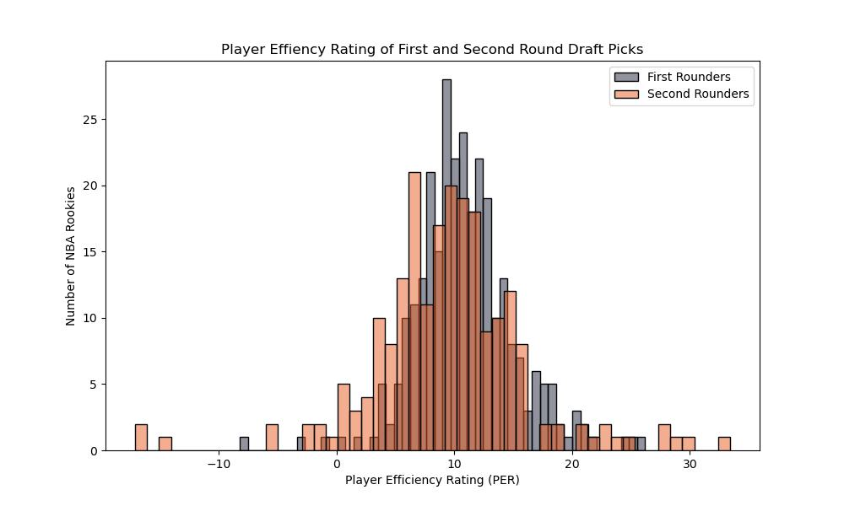
Who’s Data Are We Looking At?
NBA rookies who have been drafted in the last ten years (2014-2023)
An NBA Draft consist of two rounds of thirty picks, sixty in total
All statistics come from the rookie year of the athlete

Slide 5
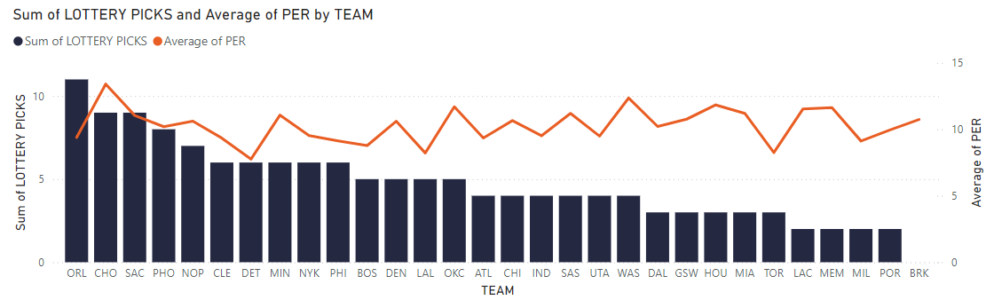
Analyzing Team’s Scouting Department
Average Player Efficiency Rating for Each Team

Slide 6
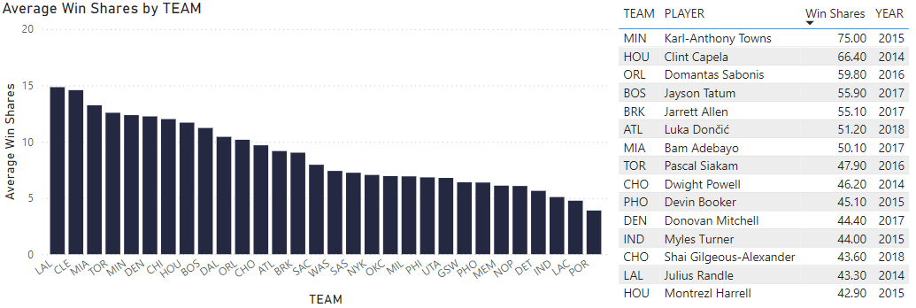
Analyzing Team’s Scouting Department
Analyzing Team’s Scouting Department
Average Win Shares for Each Team

Slide 7
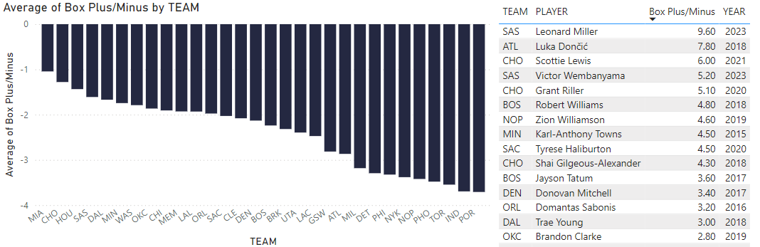
Analyzing Team’s Scouting Department
Average Box Plus/Minus for Each Team

Slide 8
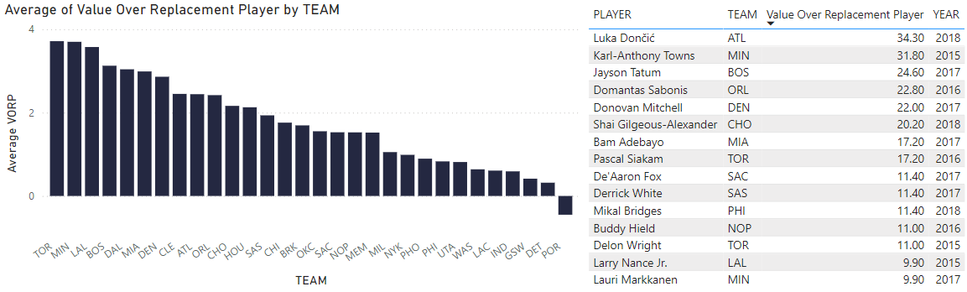
Analyzing Team’s Scouting Department
Value Over Replacement for Each Team

Slide 9






Analyzing Team’s Scouting Department
Who Was Consistently in the Top 5 and Bottom 5?
Top Scouting Performance |  | Bottom Scouting Performance
Miami Heat | 0 NBA Titles 3 Conference Titles 6 Division Titles | Portland Trail Blazers | 0 NBA Titles 0 Conference Titles 2 Division Titles
Charlotte Hornets | 0 NBA Titles 0 Conference Titles 0 Division Titles | Detroit Pistons | 0 NBA Titles 0 Conference Titles 0 Division Titles
Houston Rockets | 0 NBA Titles 0 Conference Titles 4 Division Titles | Indiana Pacers | 0 NBA Titles 0 Conference Titles 2 Division Titles

Slide 10
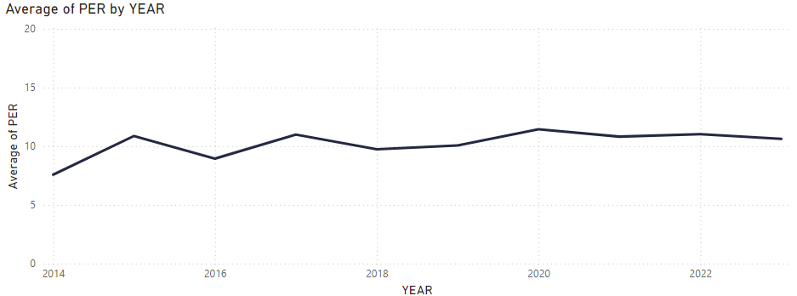
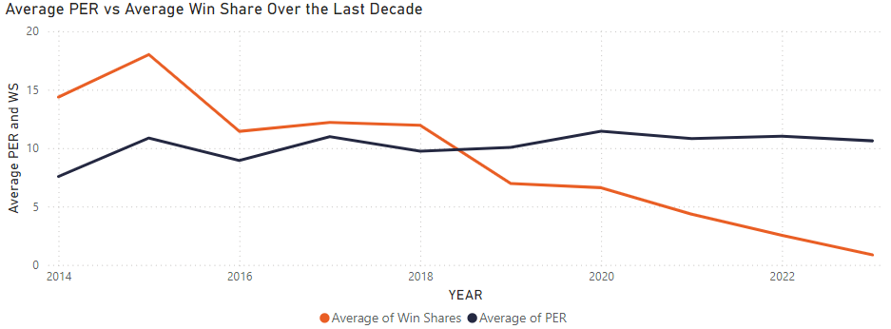
Does Efficiency Lead to Winning?

Slide 11
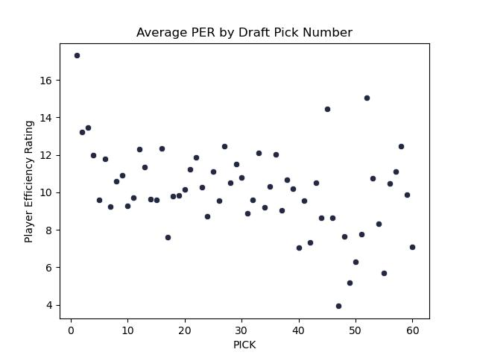
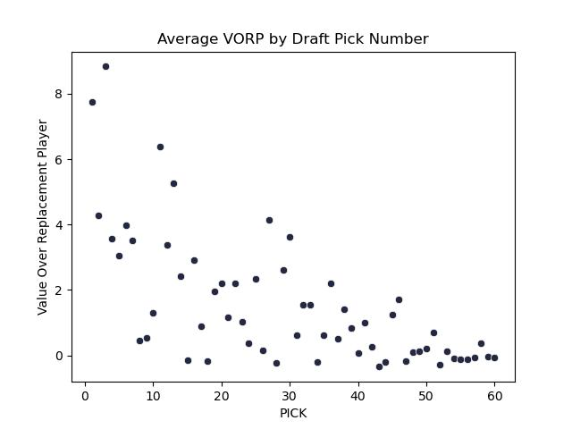
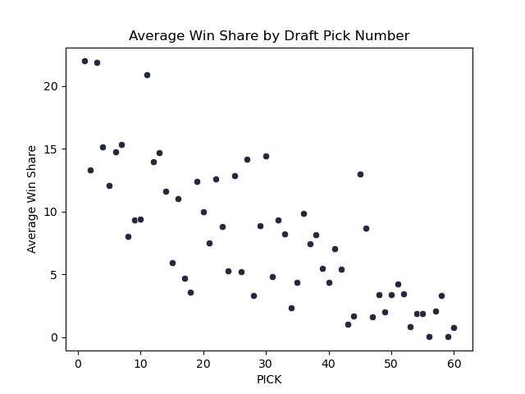
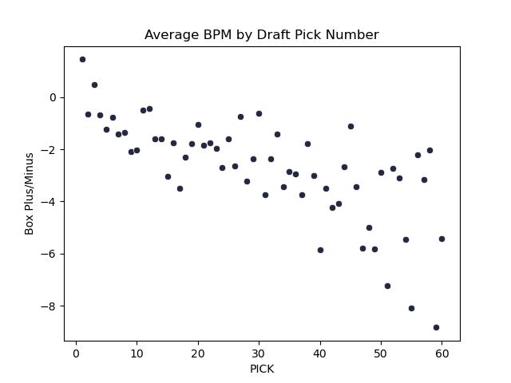
Metric Evaluation of Draft Pick
Statistical Metric | Correlation to Draft Pick
PER | -0.392
VORP | -0.665
Win Share | -0.768
BPM | -0.711

